Slide 1
Cricket Match Outcome Prediction
CAPSTONE Final Project Submission
Sudarshan John
23rd April 2016

Slide 2
Agenda
Project Objectives
Approach
Feature Selection Approach
Model Training and Selection
Technical Approach
Conclusion

Slide 3
Project Objectives
Evaluate the feasibility of predicting the outcome of cricket matches.
Select of features that are significant from an outcome prediction perspective.
Leverage supervised learning techniques to train a prediction model.
Predict the outcome of a cricket match with reasonable accuracy.

Slide 4
High-Level Approach
Data Identification
Data Procurement
Data Ingestion
Explore and Pre-Process
Feature Creation
Model Training
Model Deployment
Espccricinfo.com
Cricsheet.org
YAML files
Python YAML parser
Study data relationships.
Clean the data.
Prepare/normalize data.
Identify relevant features.
Generate new features.
Create feature vectors for model training.
Evaluate models.
Measure accuracy.
Finalize model.
Save model in pickle file.
Run input against model.

Slide 5
Feature Selection
Multiple approaches considered.
Approach 1 – Team based
Overall team metrics and performance used to build model.
Factors like head-to-head results and home-advantage had a significant impact on outcomes.
Approach discounted the fact that presence of certain players had a significant impact on the outcome.
Approach 2 – Player based
Presence of players used to build feature vectors.
Strong co-relation between presence of players on the team and match outcomes.
Approach selected
Approach 2 – Player based was chosen as it was able to capture variations in outcomes caused by the presence of certain players, something that the team based approach could not capture.

Slide 6
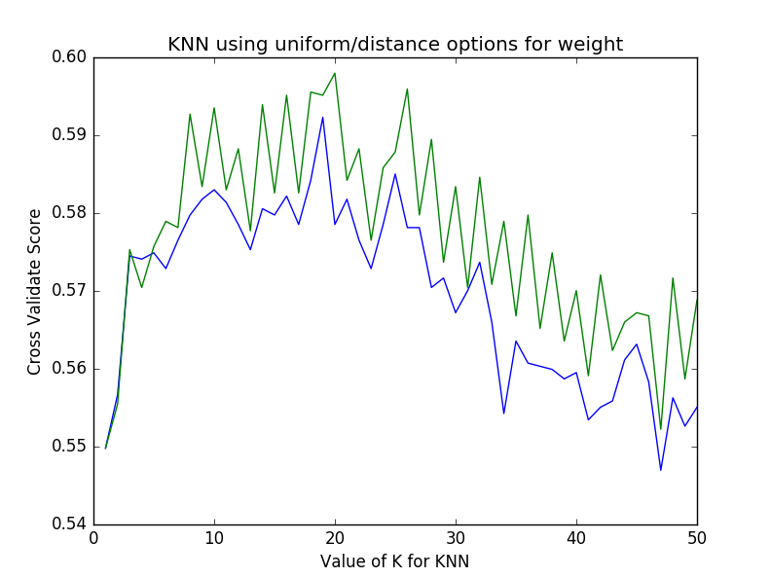
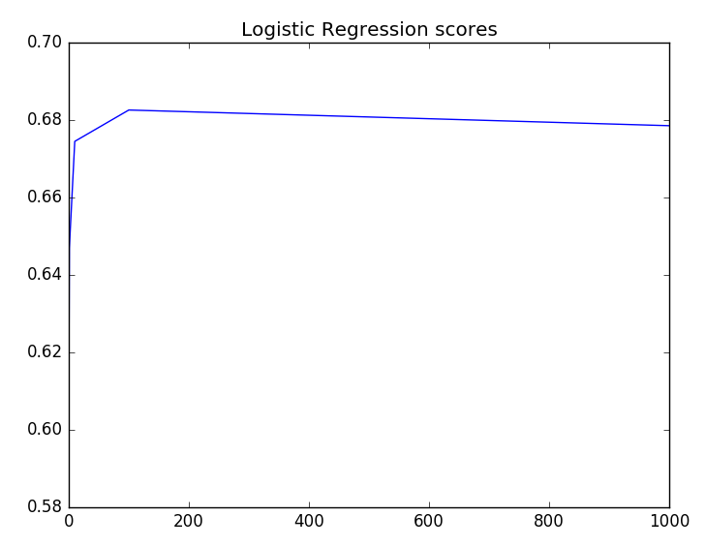
Model Training
KNN
Logistic Regression

Slide 7
Model Selection
Approach 1 – Team Based
Approach 2 – Player Based
# | Model Name | Measured Accuracy
1. | K Nearest Neighbors | 0.61
2. | Logistic Regression | 0.60
3. | Decision Trees | 0.64
# | Model Name | Measured Accuracy
1. | K Nearest Neighbors | 0.60
2. | Logistic Regression | 0.68


Slide 8
Technical Approach
Feature Vector
Cricsheet.org
0 | 1 | 0 | 0 | 0 | 0 | 1 | 1 | 1 | 1 | 1
YAML input
Input Files
YAML Parser
Pre-Processing & Data Preparation
Model Training
Parsed Data (csv file)
Cleaned Data (csv file)
Reference Data (sqllite DB)
Input Data
Trained Model (pickle file)
Predicted Output

Slide 9
Conclusion
It is possible to predict the outcome of cricket matches with a reasonable level of accuracy, though with lower accuracy compared to other sports.
The most effective classification method was a simple Logistic Regression model combined with significant data pre-processing and feature selection methods.
With regards to future work, further avenues could be explored either in the form of new algorithms or in the form of new features primarily categorical features, such as ‘home team’, ‘who won the toss’ and combining these feature types that could perhaps yield performance gains.
In addition, external data such as the weather or social media comments could be mined to provide even more features for further experimentation.

Slide 10
Resources
Data
Data was primarily sourced from the cricsheet website (http://www.cricsheet.org)
Cricsheet will provide ball-by-ball data for Test Matches, One-day internationals, Twenty20 Internationals, some other international T20s, and all Indian Premier League seasons
Total 2000+ matches (including Test, T20, and ODI)
Total dataset size: 300+ MB
Software
Python 2.7, Anaconda, Ubuntu 14.1, Spyder IDE, matplotlib, SQLLite DB.
Various Python libraries

Slide 11
References
Stylianos Kampakis, William Thomas. Using Machine Learning to Predict the Outcome of English County twenty over Cricket Matches.
Ben Ulmer, Matthew Fernandez. Predicting Soccer Match Results in the English Premier League.
Aditya Srinivas Timmaraju, Aditya Palnitkar, Vikesh Khanna. Game On! Predicting English Premier League Match Outcomes.

Slide 12
Thank You!

